Slide 1
Multistage Speaker Diarization of Broadcast News
Author :Claude Barras, Xuan Zhu, Sylvain Meignier, and Jean-Luc Gauvain
Professor : 陳嘉平
Reporter : 楊治鏞

Slide 2
Introduction
Speaker diarization, also called speaker segmentation and clustering, is the process of partitioning an input audio stream into homogeneous segments according to speaker identity.
Audio diarization is a useful preprocessing step for an automatic speech transcription system.

Slide 3
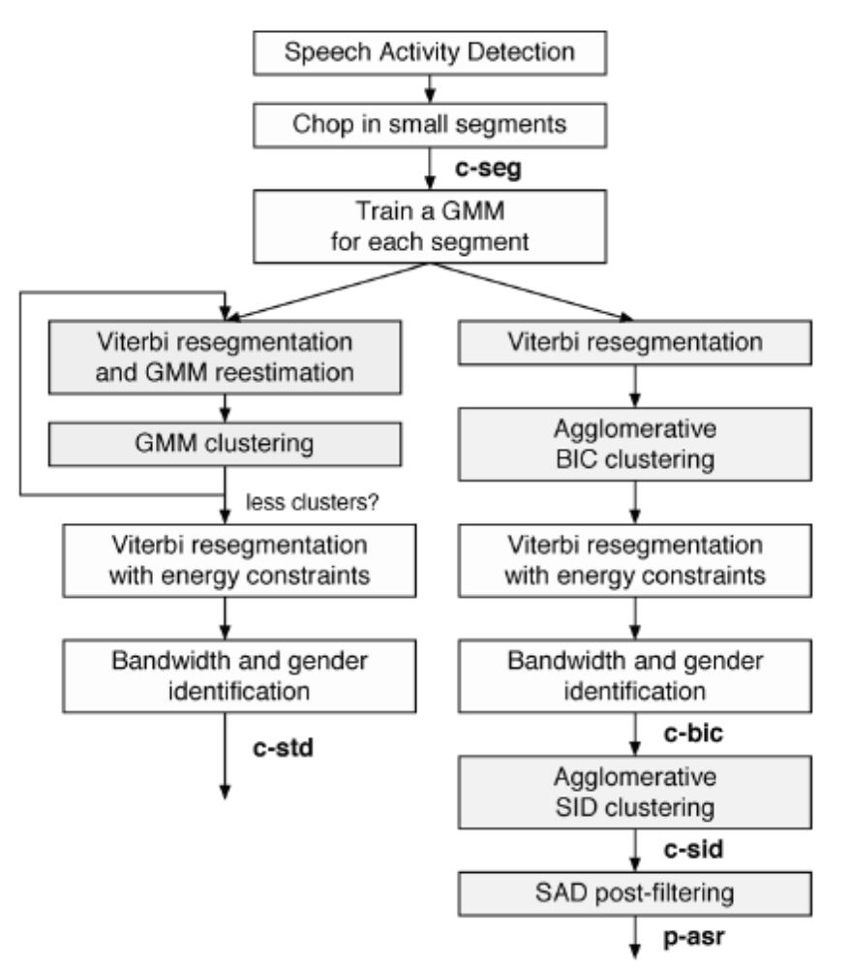

Slide 4
Feature Extraction
MFCC
The 38 dimensional feature vector consists of 12 cepstrum coefficients, 12 delta and 12 delta-delta coefficients plus the delta and delta-delta energy.
This set is used in all steps of the c-std system, except for the segmentation into small segments where only the static features are used.

Slide 5
Speech Activity Detection
Speech is extracted from the signal with a Viterbi decoding using Gaussian Mixture Models (GMM) for speech, speech over music, music, silence and noise.
The aim of the SAD is to remove only long regions without speech such as silence, music, and noise.

Slide 6






Chopping Into Small Segments
Segmentation of the signal is performed by taking the maxima of a local Gaussian divergence measure between two adjacent sliding windows and .
For each segment, the static features are modeled with a single diagonal Gaussian, i.e., and
with and diagonal.

Slide 7





Iterative GMM Segmentation/Clustering Procedure
Each initial segment is used to seed one cluster, and a GMM with 8 Gaussians and a diagonal covariance matrix is trained by maximum likelihood estimation (MLE) on the segment data.
Given a sequence of non-overlapping segments
with their associated segment cluster labels , where and .

Slide 8
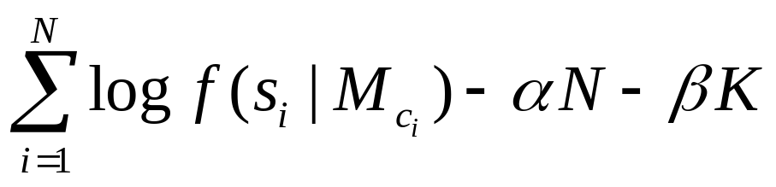





Iterative GMM Segmentation/Clustering Procedure
The objective function used is a penalized log-likelihood of the form:
where is the likelihood of the segment given the model of its cluster , and and are the segment and cluster penalties.

Slide 9
Viterbi Resegmentation
The segment boundaries are refined using the last set of GMMs and an additional relative energy-based boundary, within a 1 second interval.
This is done to locate the segment boundaries at silence portions, so as to avoid cutting words.

Slide 10
Bandwidth and Gender Labeling
Band (studio or telephone) and gender (male or female) labeling is performed on the segments using 4 GMMs with 64 diagonal covariance matrices, trained on a subset of the 1996/1997 Broadcast News data.

Slide 11
BIC Clustering (1/3)
Agglomerative clustering is applied to the segments resulting from the GMM segmentation.
Initially, each segment seeds one cluster, modeled by a single Gaussian with a full covariance matrix trained on the 12 Mel frequency cepstrum coefficients and the energy.
At each iteration, the two nearest clusters are merged until the stopping criterion is reached.

Slide 12








BIC Clustering (2/3)
In order to decide whether to merge two clusters and , the value is computed as
where is the covariance matrix of the merged cluster ( and ), of cluster , of cluster , and and are, respectively, the number of the acoustic frames in clusters and .

Slide 13

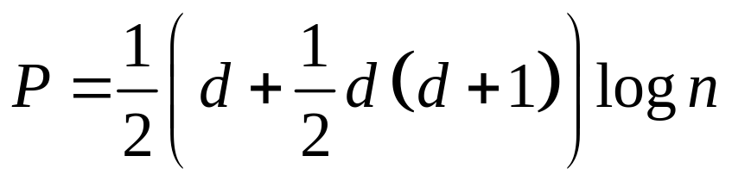


BIC Clustering (3/3)
The penalty is
where is the dimension of the feature vector space.
The merging criterion is that two clusters should be merged if

Slide 14
SID Clustering (1/4)
After several iterations, the amount of data per cluster increases, so a more complex model can be used.
Our approach is to stop the initial clustering stage early, and use the results to seed a second clustering stage with more initial data per cluster.
This second stage can therefore estimate more complex models for the speakers.

Slide 15
SID Clustering (2/4)
The feature vector consists of 15 Mel frequency cepstral coefficients plus delta coefficients and delta energy.
For each gender and channel condition (studio, telephone) combination, a universal background model (UBM) with 128 diagonal Gaussians is trained on the 1996/1997 English broadcast news data.
Agglomerative clustering is performed separately for each gender and bandwidth condition, using a cross log-likelihood ratio.

Slide 16





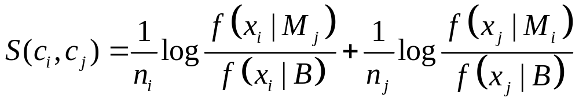




SID Clustering (3/4)
For each cluster , its model is MAP adapted from the gender and channel-matched UBM using the feature vectors belonging to the cluster.
Given two clusters and , the cross log-likelihood ratio is defined as
where is the likelihood of the acoustic frames given the model , and is the number of frames in cluster .

Slide 17

SID Clustering (4/4)
The clustering stops when the cross log-likelihood ratio between all clusters is below a given threshold optimized on the development data.

Slide 18
SAD Post-Filtering
In order to filter out short-duration silence segments that were not removed in the initial speech detection step.

Slide 19
EXPERIMENTS
Development data: 6 shows of about 30 minutes each, recorded in February 2001 (sources: ABC, CNN, NBC, PRI, VOA), referred to as ’dev1’, and 6 shows each of about 30 minutes, recorded in November and December 2003 (sources: ABC, CNBC, CNN, C-SPAN, PBS), referred to as ’dev2’;
evaluation (test) data: 12 shows lasting about 30 minutes, recorded in Dec. 2003 (sources: ABC, CNBC, CNN, CSPAN, PBS, WB17).

Slide 20
EXPERIMENTS
Cluster purity is defined as the ratio between the number of frames by the dominating speaker in a cluster and the total number of frames in the cluster.
Cluster coverage accounts for the dispersion of a given speaker’s data across clusters.

Slide 21
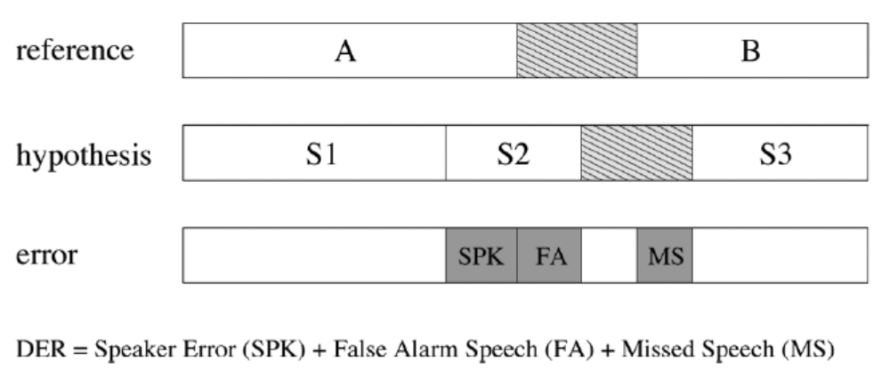
DER

Slide 22
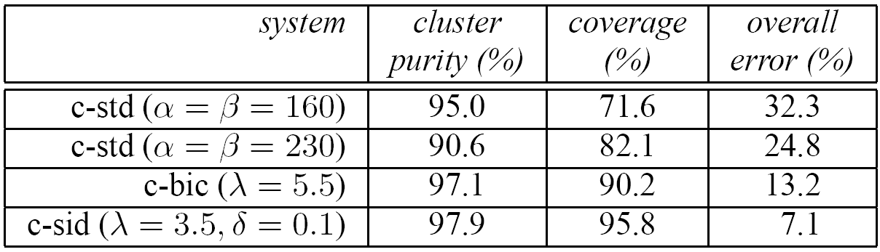
EXPERIMENTAL RESULTS

Slide 23
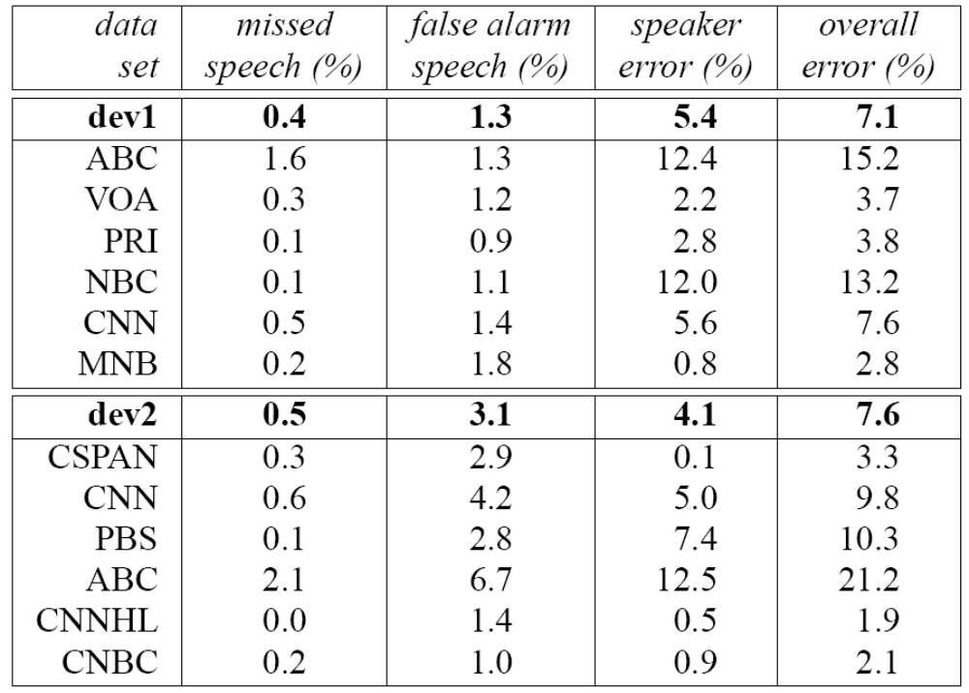

Slide 24
